Slide 1
TUMB Culture
Alumni’s Responses

Slide 2
What were the characteristics of the culture around the TUMB that as a member of the band, made your experience good?

Slide 3
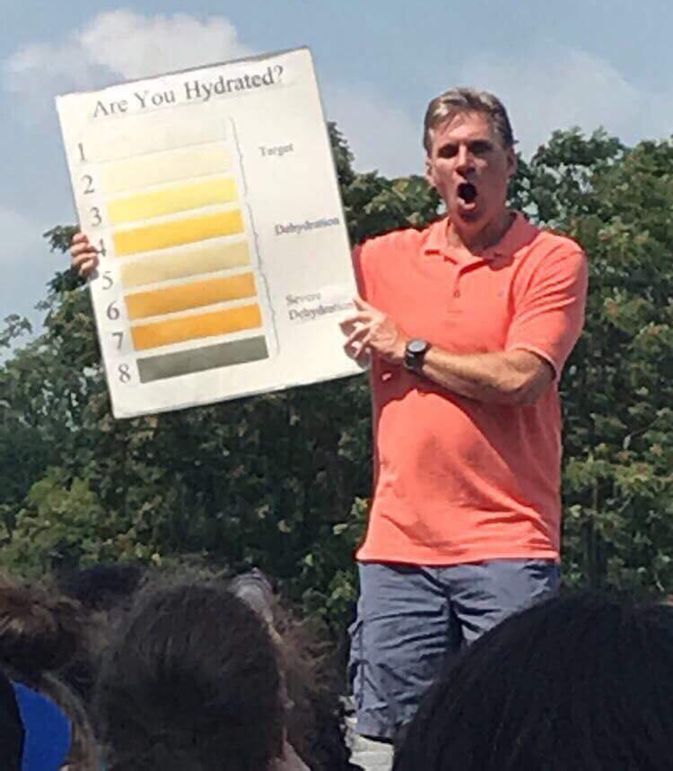
Pee Chart
The pee chart is a story I tell to this day and I still have my traffic cone.
Pizza Fridays!!!

Slide 4
Leadership opportunities
Being a member and leader of the TUMB shaped me into who I am today. I learned so much about myself, about interacting with my peers, and about working with my superiors. It really challenged me as a person and without my TUMB experiences I wouldn’t be who I am today. There were times when I had to be an “adult” and reprimand students which was VERY difficult for me. There were times when I had to direct the band and I developed my skills of music recognition and error correction. There were times when I was embarrassed by mistakes made but friends helped pick me up and make me a stronger leader. And there time (many) when I learned how to be a great instructor and leader under Mr. M. It wasn’t always pretty or easy (especially early on as we were trying to establish a new identity) but just like life, it was worth working hard at it to succeed.

Slide 5
Friendships/Family
The sense of family that came from just being a part of it. I still tell kids now when I go speak at high schools that joining the band was one of the greatest things I did because there aren’t many fraternities/sororities/sports teams/interest groups/etc that allow you to meet and interact and live and work together with 250+ people almost at once like band does. Something about knowing that your specific part, your individual dot, your role in the front ensemble, your spot in the guard formation made you individual. The fact that if you didn’t hit it or play it, everyone else looked bad made you part of a team. It was truly something special.

Slide 6
Socializing
Band was legit the BEST introduction to college. As a freshman/newcomer, I REALLY appreciate the upperclassmen wanting to become my friends. They asked about me and openly listened to me. They told me all the things I needed to know (like the lingo, where to eat, what professors were good, etc.) and they also hosted house parties where people were so responsible. Everyone made sure folks got home safe, that no one was pressuring each other, and the whole atmosphere was such a safe space and opposite of the scary house party you hear about before going to college. Plus, we all talked about band. But in general, everyone invited the newcomers to events, dinners, shows, etc. It was so very welcoming and everyone had each other's back--which was all the encouragement I needed as a newcomer not just to band, but to college.
I always appreciated the opportunities we had to socialize as a group, the band camp games, Halloween dance, banquet. So that spirit of fun outside of the work we did on the field helped create that family atmosphere.

Slide 7
Experiences
In the time I was in the TUMB as a color guard member, I enjoyed all the amazing memories and friendships I made with everyone. I felt like I was apart of a family! I enjoyed the dressing up days, the fun music we played during football games, performing the different shows on the football field, the talent show, SAUCE and performing for the high schools. I miss being a part of the marching band and still, to this day, talk about my time marching.
In my 4 years as a TUMB member, the word that comes to mind is inclusion. People of all shapes, sizes, talent levels, and backgrounds coming together to accomplish a goal and be a part of something bigger than yourself. Looking back, I appreciate the performances that we made for high school students much more than when I was a member. One performance that stands out was in 2012 in Mechanicsburg, PA, where you would have thought we were rock stars!

Slide 8
What elements or characteristics were you glad WERE NOT a part of the TUMB culture?

Slide 9
This is more a comment on Towson culture than band specific.... But I vividly recall in high school that band was not highly thought of. It felt like we were second class citizens. I always felt that at Towson, the marching band was respected.
I appreciated that even though I was brand new to marching band in college, that everyone was really kind and helpful and made me feel like part of the group instead of “less than” for not having years of experience.
I’m glad that the audition process was open. It didn't seem like we turned people away. We were willing to work with members on what skills they had. We were able to find a place for everybody.

Slide 10
Inclusion
I'm glad there wasn't a classmen hierarchy, but even more glad that staff treated students with respect and there wasn't this great divide of "the experienced people/great musicians who know everything" as teachers and "the lowly members who must show up, shut up and follow command" as students. especially in a marching band where details become super important, I think it's easy to get lost in memorizing drill/music and going through the motions as dictated. The presence of student leaders and SMAC was significant, and it made me want to work hard to make myself better and to show the people I looked up to that I was learning, listening and becoming capable of being a future leader further on in my career. it also made me hyper aware of my section and how we could work together to improve as part of the larger band organization. Thank you for encouraging an atmosphere that was open to learning from one another and being aware of our individual contributions to the entire ensemble.

Slide 11
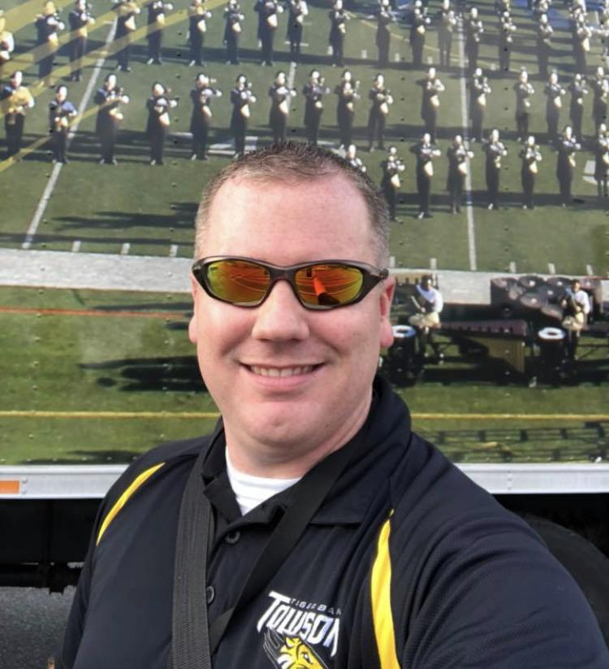
From Gary Williams Pt 1 - Entitlement
Following up on the entitlement topic, I realized that new members of the band probably don’t realize what Towson’s investment in its marching band really looks like. For example this fall, here are just a handful of items that are already in place that will be used by band members: stipends, uniforms, trucks and trailers, drum & pit equipment, electronics, staff, flags for every song, custom arranged music and drill, podiums, flip folders, stadium hardware, large school instruments. Those all look like things a marching band needs, what’s the big deal??.....well those items represent several MILLION dollars of investment that TU has made in its marching band. That’s a lot of money. Even more so when you realize that Towson has to operate on a budget and can’t just spend money on whatever it wants. Want to see that in action? Go ahead and join the men’s track team, swimming, diving, tennis, or cross country teams…well you can’t, Towson cuts those teams because it didn’t have enough money to keep them running. However, during the same period of time they cut those sports teams, they continued to invest in the marching band.

Slide 12
Pt 2 - Why?
Why? Because year in, and year out, the TUMB goes out and earns the respect that investment represents through its action on and off the field. That can’t happen every couple years when a visible event comes up. It has to happen every season, every performance, every practice. It’s so easy for someone in a budget meeting to say ‘Hey let’s move this marching band money over here for this new program. Yea they sound good but how many people care about a marching band these days?’ In moments like those what the band has done in the past doesn’t matter. You need the actions of the current band to shine through the voices of advocates we don’t even know we had: ‘I was just at the game and they were the best thing to watch’ ‘I just heard from someone at another school how respectful they were’ ‘Don’t they represent the Towson story we’re trying to tell?’ When entitlement sets in you don’t often have get those advocates so in a blink of eye, everything you’ve taken for granted can be taken away.

Slide 13
Pt 3 - To Close
To close, I’d say this to future TUMB leaders: You’ve been given a gift that many before you have worked hard to grow. But it’s yours now and we’re entrusting you to take it to new heights. If you give yourself to it, you’ll be rewarded with a lifetime of memories and friendships. And in the end, you’ll have the same sense of pride when it’s your turn to pass that gift along to the next generation of our TUMB family.

Slide 14
Activity
There are 6 stations around the room. We are going to split you up into groups that will travel to each station. Use the sticky paper to put down your groups thoughts about each poster.

Slide 15

Prompts
This makes me feel ….
This makes me think about...
Some examples of…
Do’s and Don’ts...

Slide 16
Leadership and Effective Collaboration
:-)
https://www.youtube.com/watch?v=ZnjJpa1LBOY

